Slide 1
Project Title Telco Customer Churn Analysis
Prepared By
Sulaimon Fathiat Adeola
Tool Used
Microsoft Power BI
Dataset
Telco Customer Analysis

Slide 2
Business Problem Statement
The telecommunication company is experiencing customer churn, which affects revenue and business growth.
Objectives
Identify the factors that influence customer churn.
Analyze customer behavior.
Provide data-driven recommendations to improve customer retention.

Slide 3
Dataset Overview
Source: Kaggle-Telco Customer Churn Dataset.
Total Customers : 7,032
Columns: 21
Target Variable: Churn
Data Contains;
Customer demographics
Contract type
Internet service
Payment method
Churn status
Tenure
Monthly charges

Slide 4
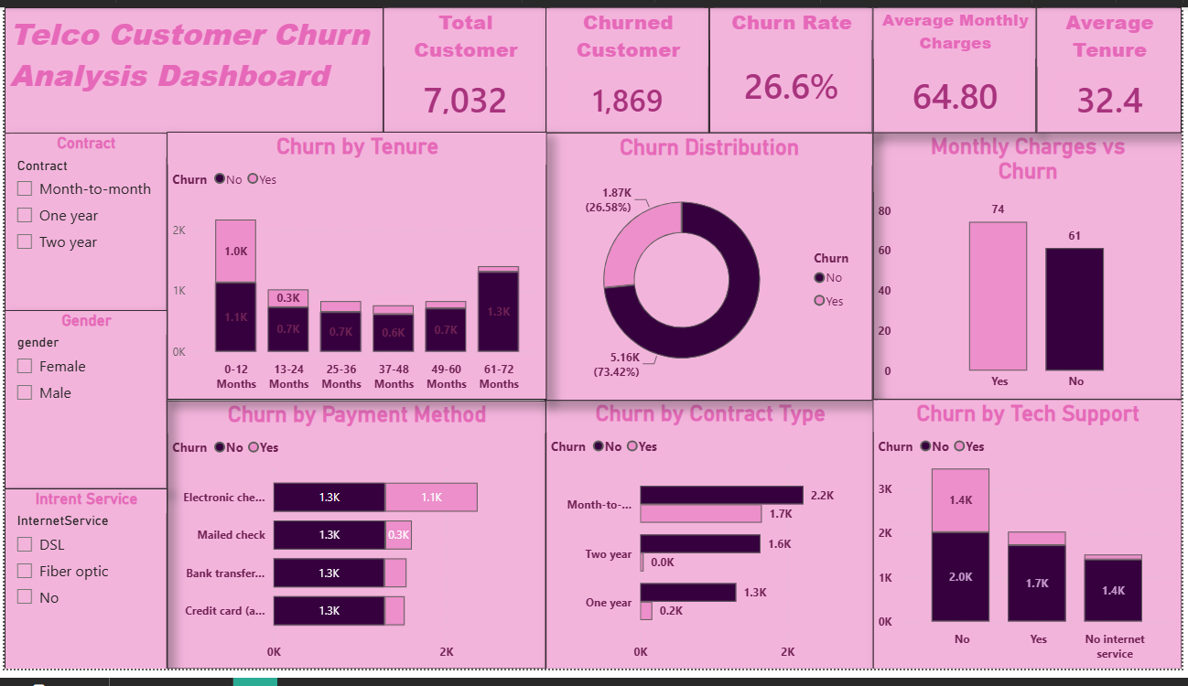
Dashboard
Dashboard includes;
KPIs Cards
Churn Distribution
Churn by Contract Type
Churn by Payment Method
Churn by Tech Support
Churn by Tenure
Monthly Charges vs Churn
Slicers

Slide 5
Major Findings
Churn rate is 26.58%
Month-to-Month contract customers have the highest churn.
Customers without tech support churn more frequently.
Electronic check users have the highest churn.
Customers with higher monthly charges are most likely to churn.
Customers in their first year are more likely to leave.

Slide 6
Recommendations
Encourage customers to switch to longer-term contracts.
Improve technical support services.
Introduce retention campaigns for new customers.
Review pricing strategies for customers with high monthly charges.
Investigate why electronic check users have higher churn and improve the payment experience.

Slide 7
Conclusion
This analysis identified the major factors driving customer churn, including contract type, tenure, monthly charges, payment support and tech support. By implementing targeted retention strategies based on these findings, the company can reduce customer churn, improve customer satisfaction, and support long-term business growth.
Thank You

